Slide 1

Project Phase#2 home sales dataset
Prafull Pandey
BAN 502 Predictive Analytics

Slide 2
Select Variables
The response variable is a character variable.
Most of the character and number variables are dropped because of inconclusive relation with response variable
13 variables are considered based on datasets and their relationship with the response variable to build the model.
Response Variable:
Above_Median : Character
Predictor Variables:
Overall_Qual : Character
Neighborhood : Character
BsmtFin_Type_1: Character
Heating_QC : Character
Garage_Finish : Character
Year_Built : Number
Year_Remod_Add: Number
Gr_Liv_Area : Number
Full_Bath : Number
TotRms_AbvGrd : Number
Fireplaces : Number
Garage_Cars : Number
Garage_Area : Number

Slide 3
Model Preparation
The seed(123) is used for model consistency,
Data is split into 70-30 ratio,
70% of data is reserved for model training,
30% of data is reserved for model testing,
3 models (Logistic Regression, Classification Tree and Random Forest) are tested for the accuracy

Slide 4
Model Observation (Confusion Matrix)
Model Name | Accuracy- Training | Accuracy-Testing
Logistic Regression | 94.2% | 90.1%
Classification Tree | 92.1% | 87.5%
Random Forest | 96.9% | 89.9%
Model Name | Sensitivity- Training | Sensitivity--Testing
Logistic Regression | 94.8% | 92.0%
Classification Tree | 92.3% | 87.2%
Random Forest | 97.0% | 86.6%
Model Name | Specificity- Training | Specificity--Testing
Logistic Regression | 93.5% | 88.1%
Classification Tree | 91.9% | 87.8%
Random Forest | 96.8% | 93.4%

Slide 5
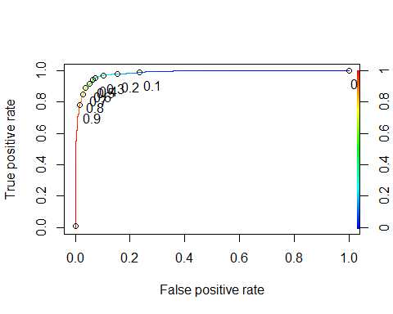
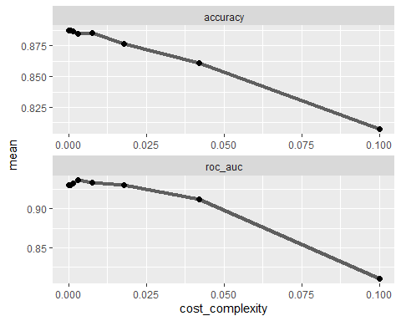
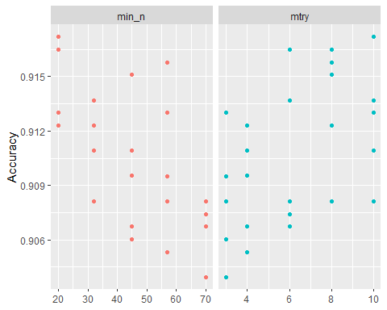
Model Observation (Confusion Matrix)
Logistic Regression Model
Classification Tree Model
Random Forest Model

Slide 6
Analysis Summary
No Missing Value in dataset
13 selected predictors are combination of nominal and quantitative variables.
Random Forest Model is better over Logistic Regression and Classification Tree models for given dataset.
Accuracy has declined for testing dataset across all tested models.

